Slide 1

Used Mobile devices dataset
By- Deepshi Sachan

Slide 2
Business Goal:
Business we are representing sells used mobile devices at competitive prices.
Identify competitive phone price so that business can acquire customer and increase revenue by promoting attractive deals.
Identify combination of features in mobile devices that could have impact on used device price.
Notes:
Here we are representing businesses that sell used mobile devices at competitive price.
Our business goal is to generate high revenue by identifying low price phone so that Business can attract more & more customer by showing good cheaper deals on their websites
Identify different combinations of features that affect the pricing strategy of used mobile devices

Slide 3
Analytical Approach
Regression Model (Used Price prediction)
Normalized_used_price = Outcome variable
Predict the price of used mobile devices- identify different predictors that impact the pricing.
Classification model (low vs high price prediction)
Classify price of the used phone will be high or low.
This will allow businesses to provide consumers with information around good deals (cheaper prices)
Unsupervised Clustering Model (Identifying features that drive price)
Grouping similar devices together based on their price determinants
Notes:
By analyzing features such as screen size, camera specifications, internal memory, operating system and other properties, the project aims to understand how these factors affect the pricing of used phones. To do this we are going to create 2 predictive
Will predict how much the used mobile device will cost. This might help businesses in setting up the prices of used mobile devices.
Classification model : Classify price of used phone as high or low based on depreciation or percent drop in price. This will allow businesses to provide consumers with information around good deals (cheaper prices) vs costly premium options. User can compare phones that have high discount or low.
Cluster: group similar devices together based on their price determinants

Slide 4
Data Exploration
Dataset contains 3454 rows and 15 variables.
Handled missing values.
Days used are negatively correlated with used price which is obvious it tells the trend in price with an increase in phone used days.
Normalized used prices are strongly correlated with screen size, rear_camera_mp, front_camera_mp, ram, battery.
No multicollinearity.
Notes:
3- which tells that the price of phone will decrease with an increase of number of days devices have been used.
4 -Which tells that the price of phone will increase with an increase in phone camera resolution, screen size, and RAM.
It contains different features of the phone like screen size, internal memory, Ram, etc.

Slide 5
Visualization
Notes:
mobile devices with good back camera will result in higher price of the used mobile devices.
that 4G enabled phones have higher mp camera both rear and front and prices of used mobile devices tend to be little higher when compared with No 4G enabled phones.

Slide 6
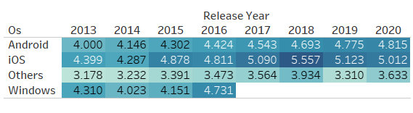
Notes:
Price of different os devices are increasing with an increase in year. Seems like most of window's devices stop releasing in 2016.

Slide 7
Data Partition
Training
Validation
Test
60%
20%
20%
Notes:
*** Normalized the data

Slide 8
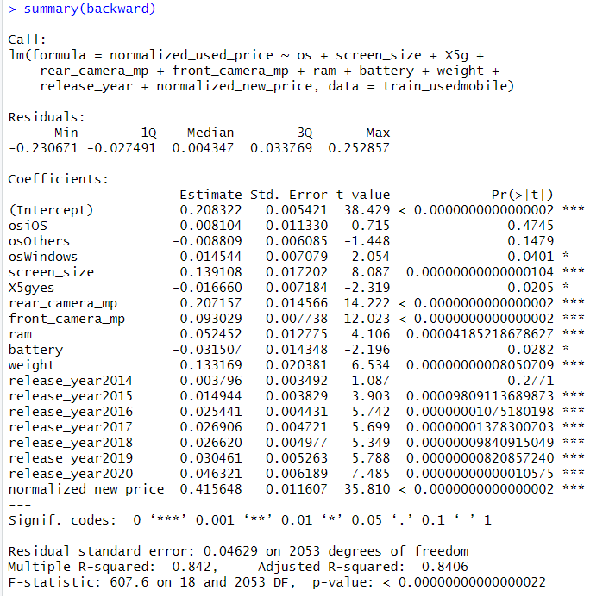
Regression Model
To predict the price of used mobile devices based on different features.
Stepwise Regression Model
For Predicting Used Price Outcome Variable (on Validation dataset)
 | MAE | RMSE | Correlation
Linear Regression | 0.1892305 | 0.239135 | 0.918035
Stepwise Regression | 0.188039 | 0.2380398 | 0.9189141
Regression Tree | 0.236836 | 0.3042452 | 0.8638877
For Holdout | MAE | RMSE | Correlation
Stepwise Regression | 0.1781837 | 0.2252125 | 0.91999
Notes:
The goal of using a regression model in used mobile devices price prediction is to provide accurate and reliable estimates of the prices of used mobile devices based on their features, helping businesses in making informed decisions in the secondary smartphone market.
To find the price of used mobile devices we will build a regression model and to classify devices into high or low-price device based on percentage drop in price will build classification model which is derived from percentage drop in price of mobile device.

Slide 9
Classifying Used mobile device into: High or Low-price devices based on percentage drop in price (Create New variable- Percent_PriceDrop)
High Percentage drop in price (1)
When percentage drop in price is greater than mean value i.e., 16.42%.
Low Percentage drop in price (0)
When percentage drop in price is less than or equal to 16.42%
Notes:
High percentage drop in price means low price of the phone compared to original / new phone price.

Slide 10
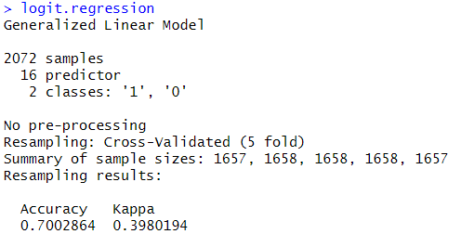
Classification Model
To classify the used mobile devices as low or high price phone.
Logistic Regression model
Outcome = CAT.Used_Price (Positive class = 1)
For Classification model (on Validation dataset)
 | Accuracy | Sensitivity | Specificity
Logistic Regression | 0.6913 | 0.6917 | 0.6910
Decision Tree | 0.6783 | 0.6282 | 0.7289
Decision tree with trial = 7 | 0.7 | 0.6254 | 0.7755
Naïve Bayes | 0.6609 | 0.6398 | 0.6822
KNN (k=5) | 0.6014 | 0.5418 | 0.6618
KNN (k= 20) | 0.6130 | 0.5331 | 0.6939
For Holdout | Accuracy | Sensitivity | Specificity
Logistic Regression | 0.6749 | 0.6246 | 0.7581

Slide 11
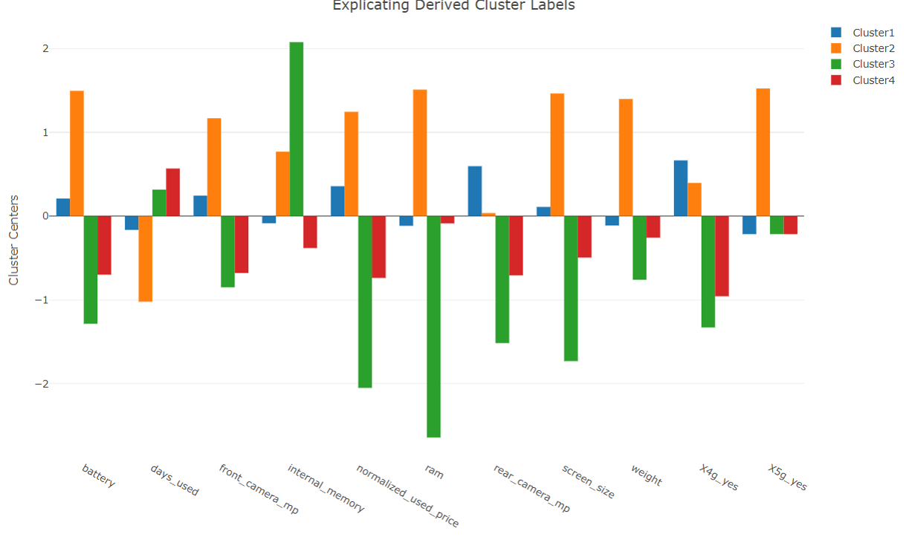
Clustering
K-Means clustering model (K=4)
Cluster 1: Average features phone like medium front camera, medium RAM, high rear camera and 4G connectivity with a medium price of the used mobile devices.
Cluster 2: High features phone with 4G and 5G enabled phone, high front& rear camera, and their price is higher.
Cluster 3: Mobile devices that have less screen size, low rear camera, are neither 4G nor 5G enabled phones, and low RAM (low features phones) but with high internal memory have been used for longer days but not longer than cluster 4 devices and their price is comparatively least.
Cluster 4: Low feature phone with no 4G & 5G connectivity and has low price but not lower than Cluster 3 devices and mobile devices have been used for longer days.
Notes:
Clustering analysis insight can help business provide better guidance to customers on how choosing (not choosing) certain features can vary prices of the used mobile devices.

Slide 12

Recommendation
Target selling high percentage drop in price of phones as it will sell faster and increase the net sale of the company.
If business are purchasing devices from third party, then they should buy less such mobile devices that have low percentage drop in price because it will take longer to sell that mobile device in the market. And focus more on high depreciation phones.
Provide additional deals to acquire more customers.

